Slide 1
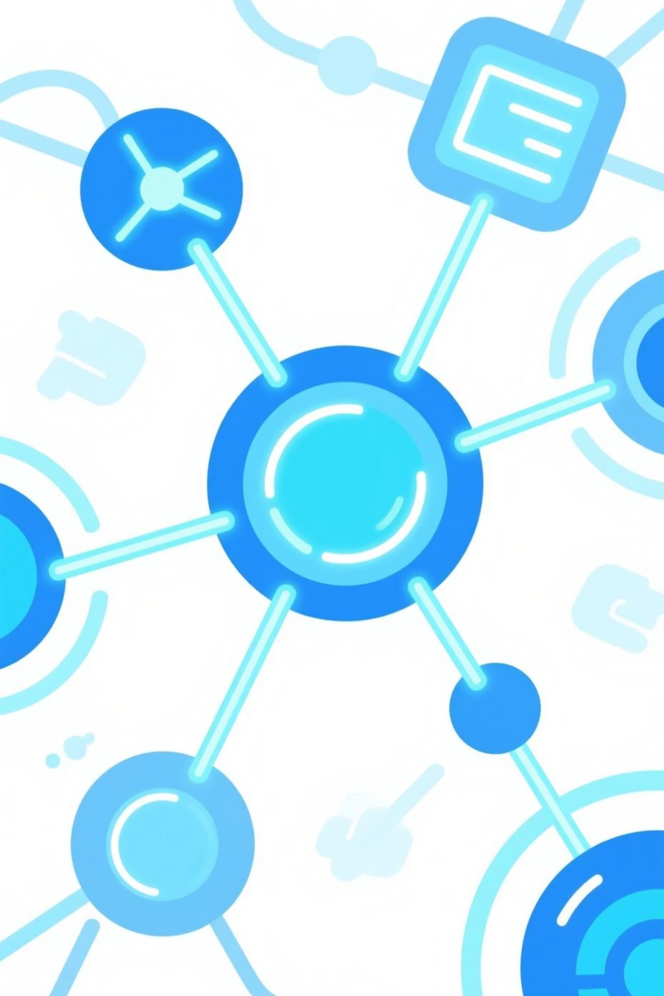

Artificial Intelligence in the Internet of Things (AI + IoT)
Name : Mohammed Sakib Hasan
ID: 2102052
Course Code : CIT-315
Course TiTle : Artificial Intelligence
Notes:
1

Slide 2
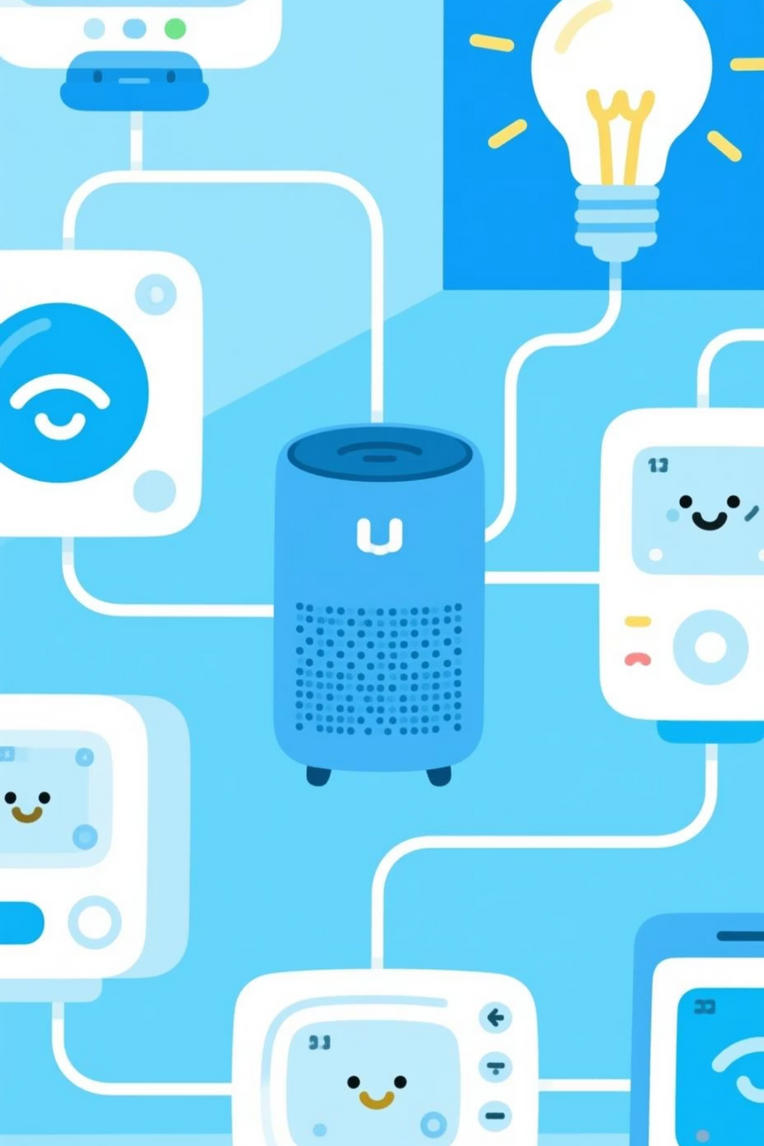



Understanding the Internet of Things (IoT)
The Internet of Things (IoT) describes the network of physical objects embedded with sensors, software, and other technologies for the purpose of connecting and exchanging data with other devices and systems over the internet. It transforms everyday objects into 'smart' devices.
Sensors & Devices
Connectivity
The physical layer, collecting data from the environment or user interaction.
Enabling data transmission via Wi-Fi, Bluetooth, cellular, or other protocols.
Cloud & Analytics
Storing, processing, and analysing the vast amounts of collected data.
Notes:
2

Slide 3
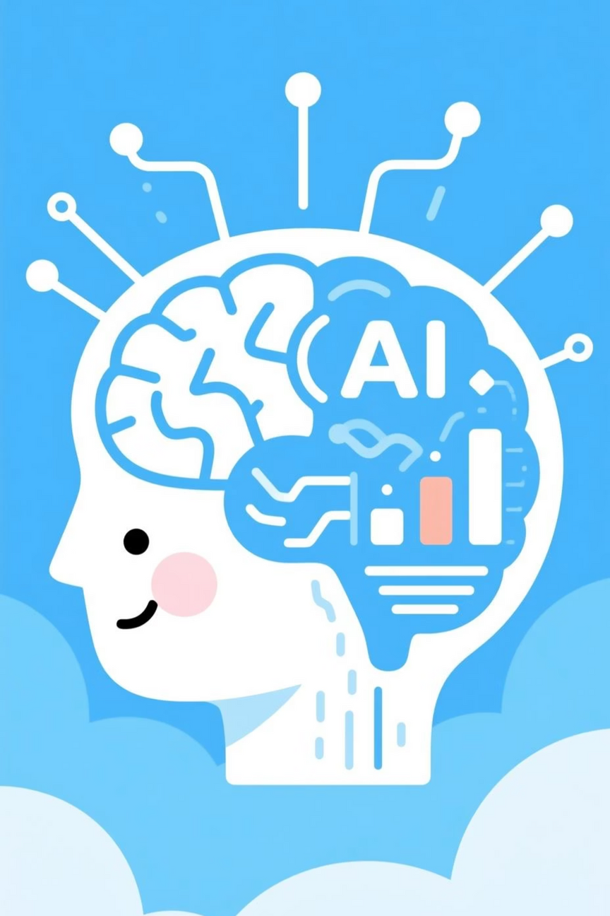




Introduction to Artificial Intelligence (AI)
Artificial Intelligence refers to the simulation of human intelligence in machines that are programmed to think like humans and mimic their actions. It empowers systems to learn, reason, perceive, and make decisions.
Machine Learning
Algorithms that learn from data without explicit programming.
Deep Learning
Advanced ML using neural networks to process complex patterns.
Natural Language Processing
Enabling machines to understand and generate human language.
Computer Vision
Allowing computers to 'see' and interpret visual information.
Notes:
3

Slide 4
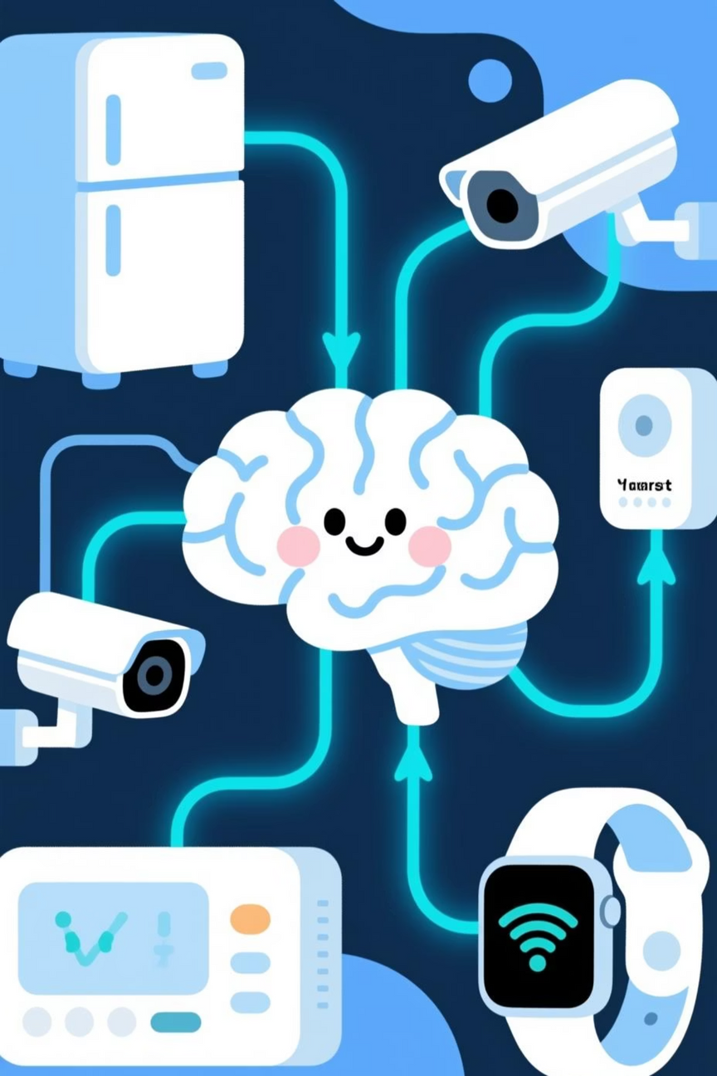



The Synergy: AI Enhancing IoT
The true power of IoT is unleashed when combined with AI. AI provides the intelligence to analyse the massive datasets generated by IoT devices, turning raw information into actionable insights and automating responses.
Data to Insights
AI processes IoT data to uncover hidden patterns and valuable insights.
Insights to Automation
Automated actions and decision-making based on these insights.
Automation to Efficiency
Resulting in optimised processes, reduced costs, and enhanced performance.
Notes:
4

Slide 5
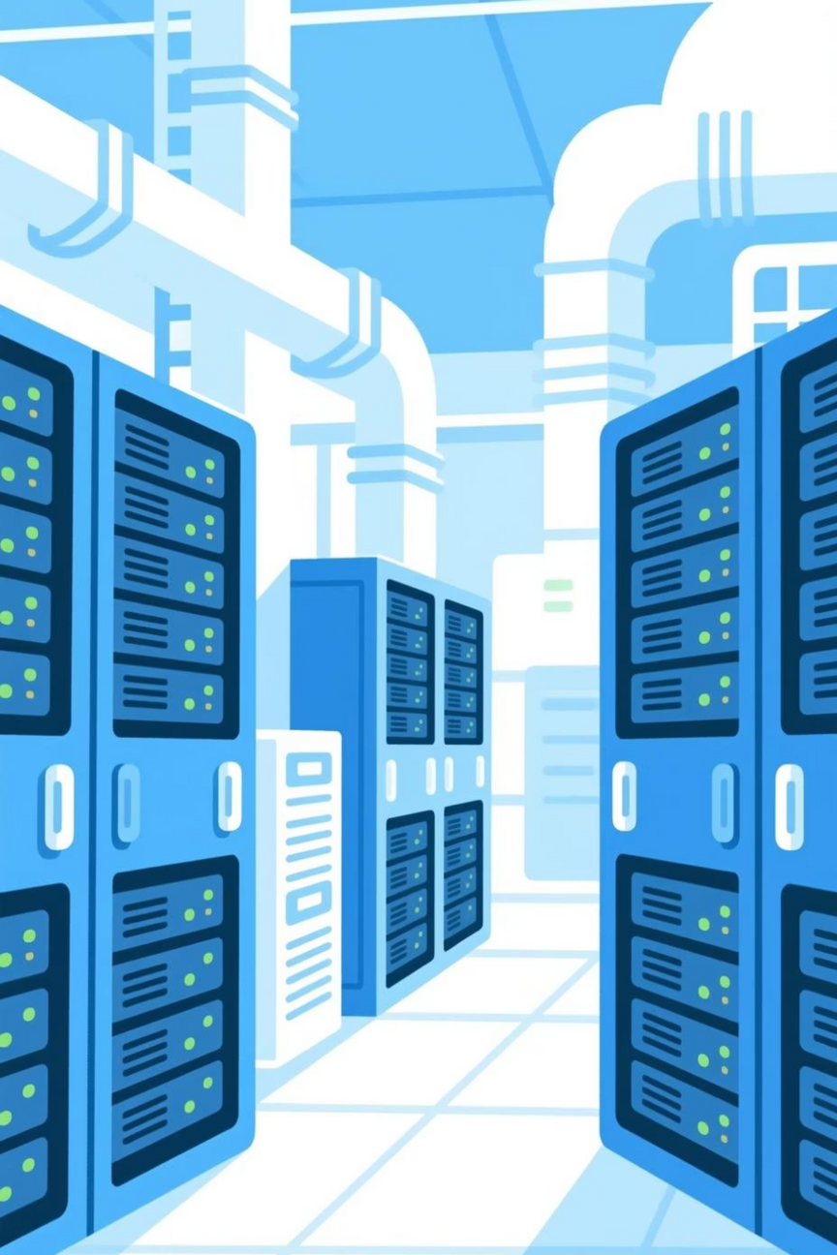
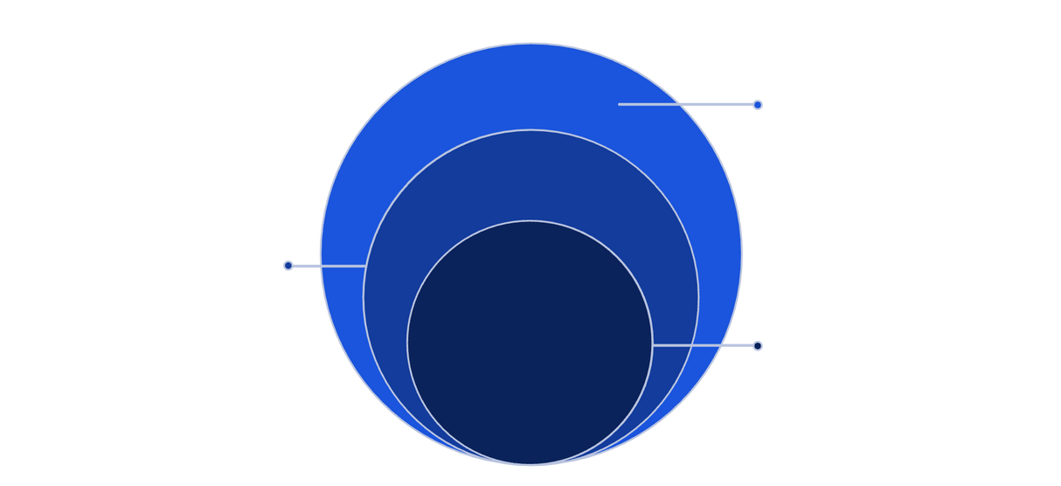
Architecture of an AI-enabled IoT System
A robust AI-enabled IoT system comprises several interconnected layers, each playing a crucial role in data flow, processing, and intelligent decision-making.
Edge & Sensors
Sensing devices and secure connectivity
Data & Processing
Stream handling, storage, and feature engineering
Core AI Decisions
Real-time inference and actions from models
This layered approach ensures seamless integration and operation, from data collection at the edge to intelligent actions at the application level.
Notes:
5

Slide 6




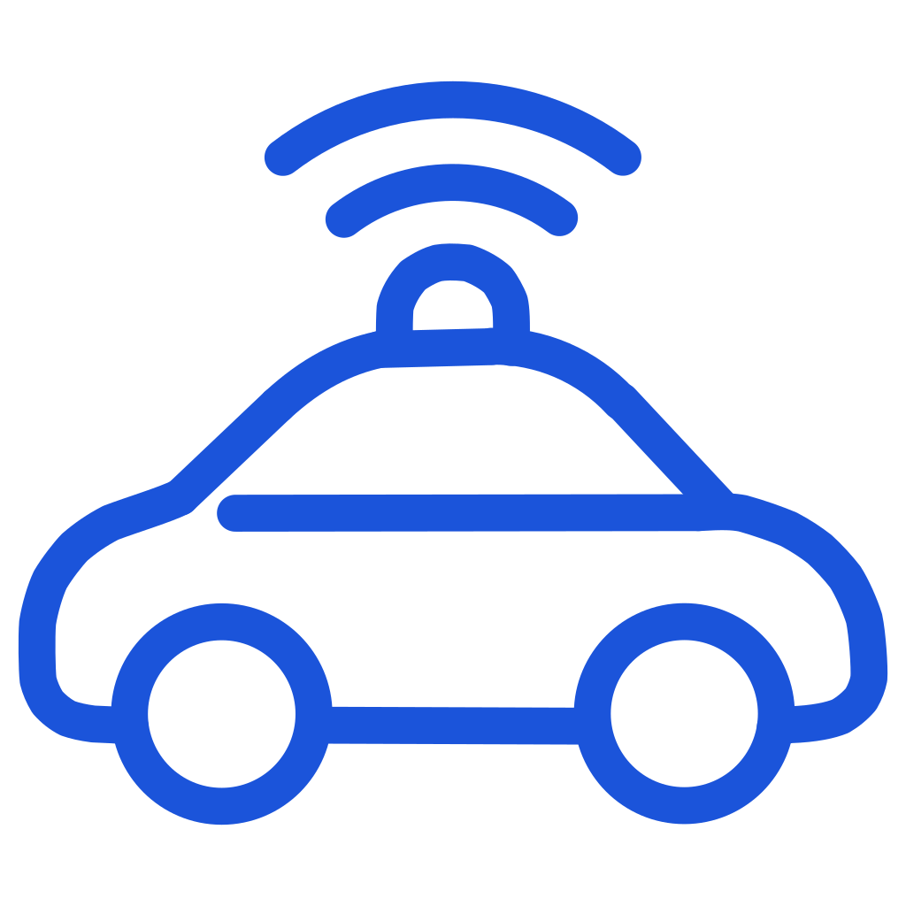

Diverse Applications of AI in IoT
The integration of AI and IoT is transforming various sectors, creating smarter environments and more efficient processes.
Smart Homes
Smart Cities
Automated lighting, climate control, and security systems.
Optimised traffic management, waste collection, and public safety.
Industrial IoT (IIoT)
Healthcare IoT
Predictive maintenance, quality control, and supply chain optimisation.
Remote patient monitoring and personalised health insights.
Autonomous Vehicles
Agriculture
Self-driving cars and intelligent transportation systems.
Precision farming, crop monitoring, and automated irrigation.
Notes:
6

Slide 7
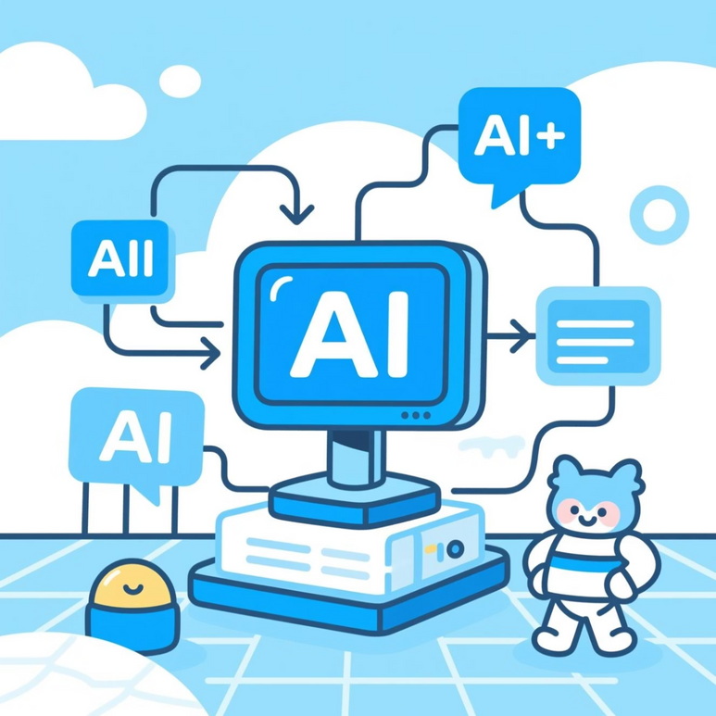
Key AI Techniques Driving IoT Innovation
Specific AI methodologies are crucial for unlocking the full potential of IoT data, enabling devices to act intelligently.
Machine Learning: Essential for predictive analytics, anomaly detection, and pattern recognition from sensor data.
Computer Vision: Enables IoT devices with cameras to understand visual information, crucial for security, quality control, and autonomous systems.
Natural Language Processing (NLP): Facilitates voice-controlled IoT devices and enables human-machine interaction through natural language.
Edge AI vs. Cloud AI: Processing data closer to the source (Edge) for real-time decisions and reduced latency, complementing extensive cloud-based analytics.
Notes:
7

Slide 8
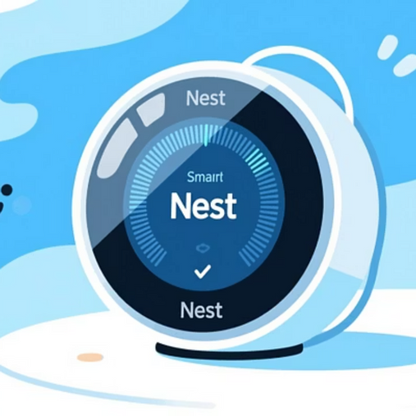
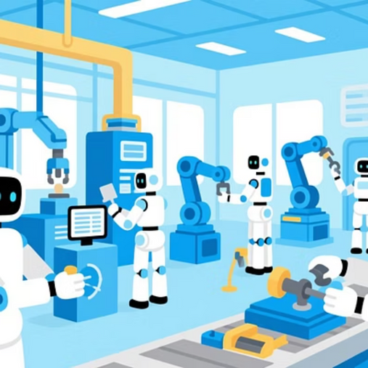
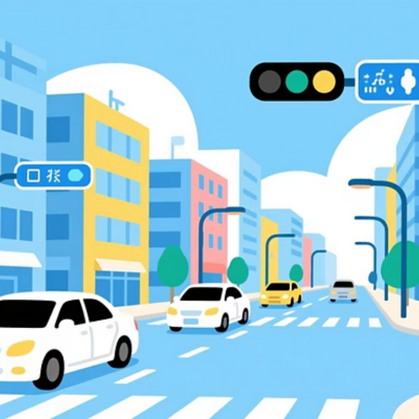

Real-World Case Studies: AI + IoT in Action
Numerous examples demonstrate the transformative impact of AI integrated with IoT across various industries.
Smart Thermostats (e.g., Nest)
Industrial Predictive Maintenance
AI learns user preferences to optimise energy consumption, saving costs.
AI analyses sensor data from machinery to predict failures, reducing downtime.
Smart Traffic Control Systems
Remote Health Monitoring
AI optimises traffic flow in real-time, reducing congestion and pollution.
Wearable IoT devices with AI analyse vital signs, detecting anomalies and alerting caregivers.
Notes:
8

Slide 9
Advantages of AI-Powered IoT
The fusion of AI and IoT brings forth a multitude of advantages, revolutionising how we interact with technology and the world around us.
Enhanced Automation
Predictive Analytics
Increased Efficiency
Autonomous systems that streamline operations and reduce manual effort.
Forecasting future events, enabling proactive decision-making.
Optimised resource utilisation and operational performance.
Real-time Decision Making
Reduced Human Error
Instant responses to dynamic conditions, enhancing responsiveness.
Minimising mistakes through intelligent automation and analysis.
Notes:
9

Slide 10
The Future Potential: AIoT Ecosystems
The future of AI and IoT is poised for unprecedented growth, driven by key technological advancements and the creation of integrated ecosystems.
01
02
03
Edge Computing Dominance
5G and Ultra-fast IoT
Truly Autonomous Systems
More data processing at the device level, reducing latency and bandwidth.
High-speed, low-latency connectivity enabling new applications.
Advanced AI leading to fully self-managing and self-optimising systems.
04
05
Integrated AIoT Ecosystems
Hyper-automation
Seamless collaboration between diverse AIoT devices and platforms.
Combining AI, ML, and RPA to automate increasingly complex processes.
Notes:
10

Slide 11
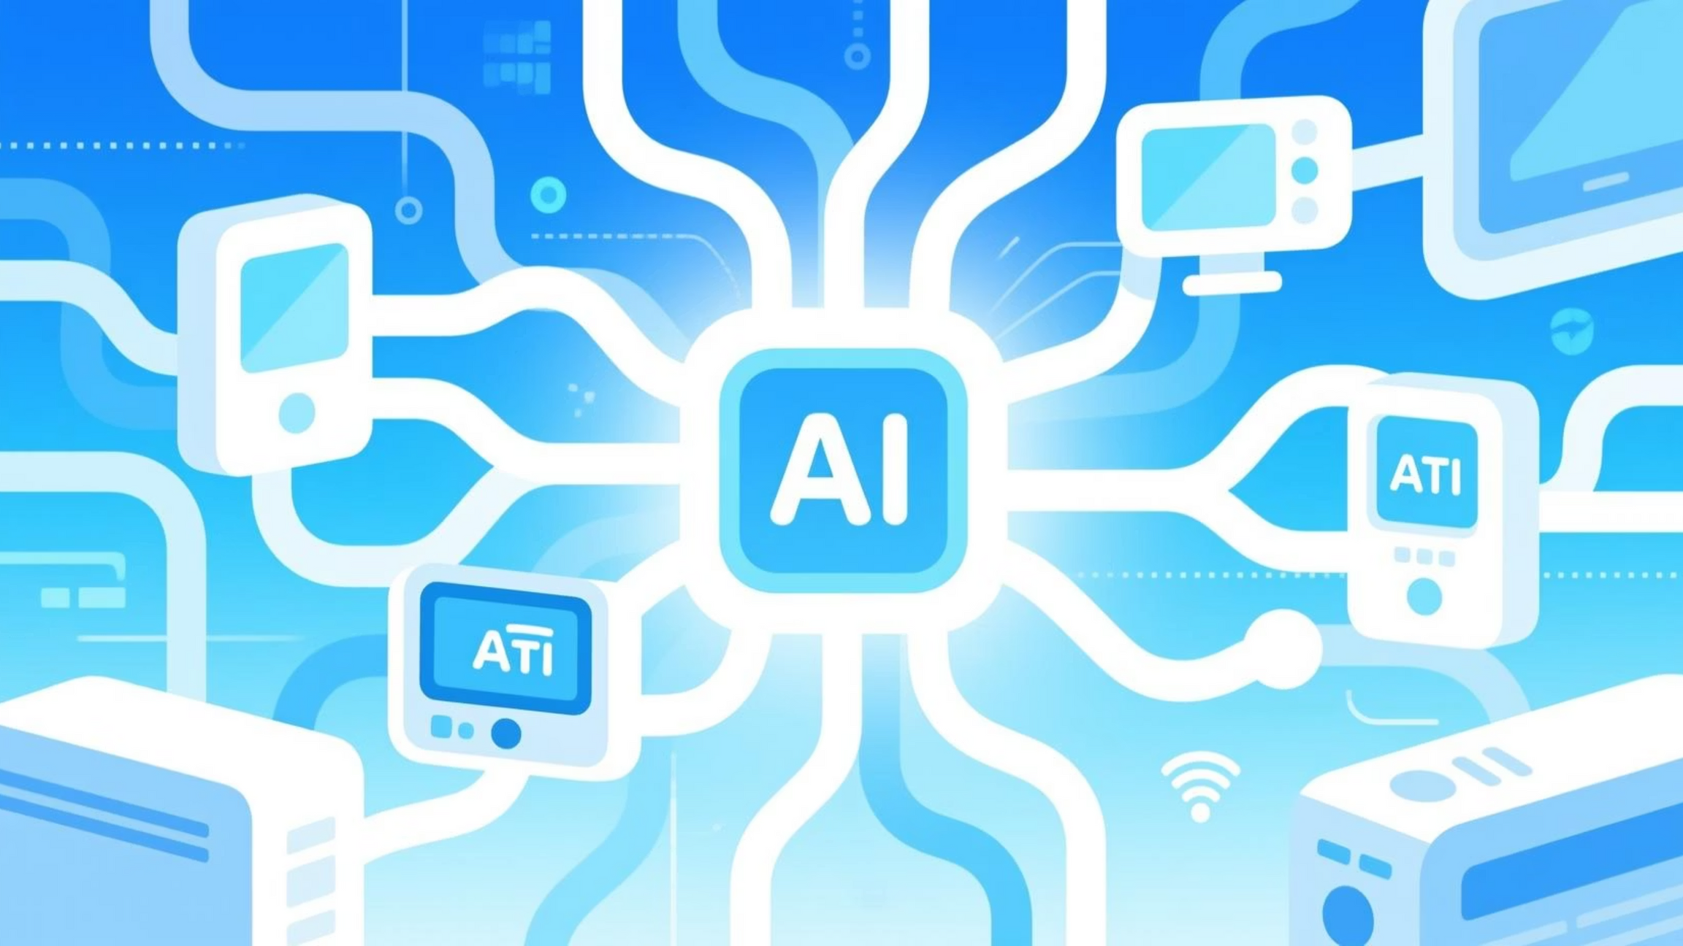
Thank You
Notes:
11

